Slide 1
CHAPTER 4
THE IMAGE PROCESSING TOOLBOX

Slide 2
WHAT WILL WE LEARN?
Reading an image from file
Main data classes used for image representation and conversion between them
Image Display
Explore content of an image
Save image

Slide 3
The Image Processing Toolbox (IPT): essential functions and features
Displaying information about an image file
Reading an image file
Data classes and data conversions
Displaying the contents of an image
Exploring the contents of an image
Writing the resulting image onto a file

Slide 4
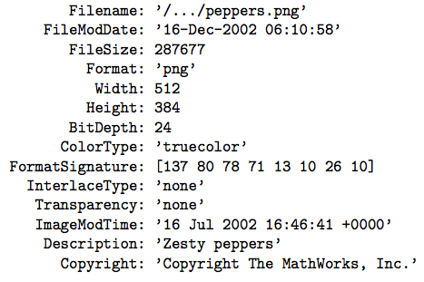
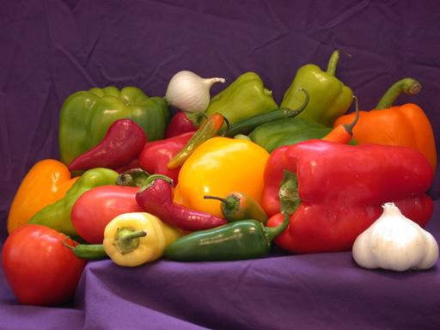
The Image Processing Toolbox (IPT): essential functions and features
Displaying information about an image file
imfinfo (‘peppers.png’)
Example 4.1 (page 62)

Slide 5
The Image Processing Toolbox (IPT): essential functions and features
Reading an image file
imread
dicomread
nitfread
hdrread

Slide 6
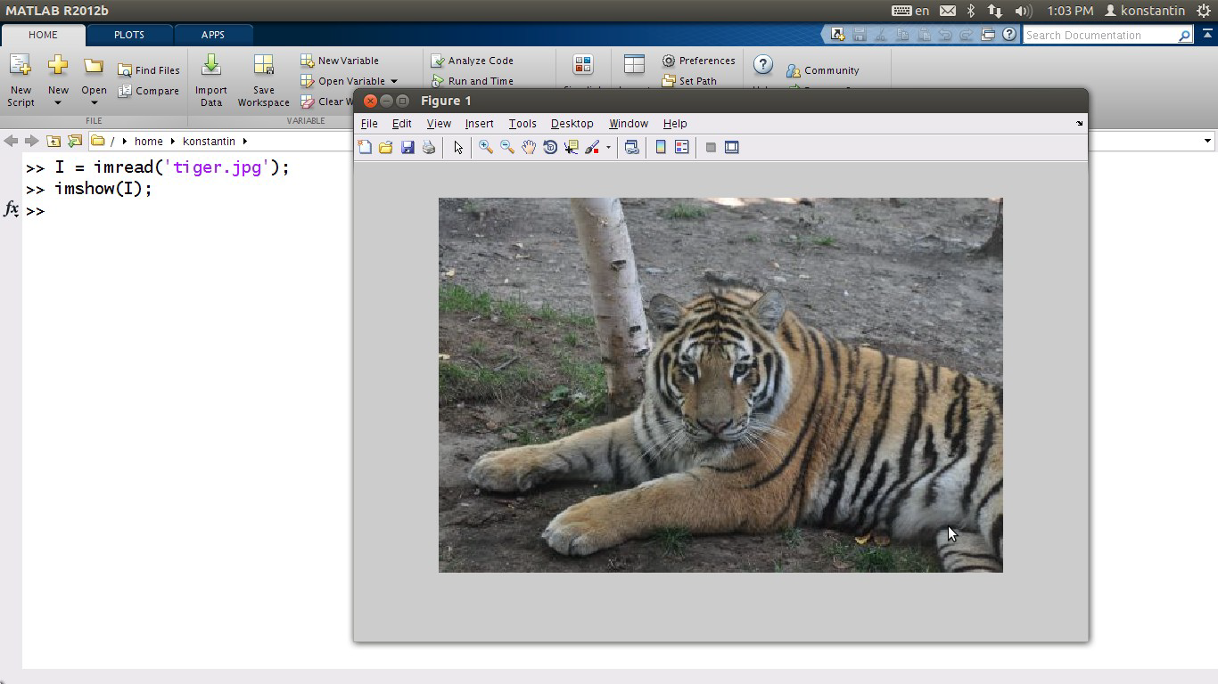
Reading and showing an image

Slide 7
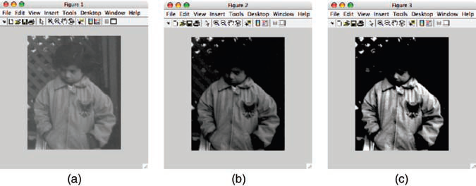
I = imread(’pout.tif’);
imshow(I)
figure, imshow(I,[ ])
figure, imshow(I,[100 160])

Slide 8
Image Data Classes
Most common data classes for images
uint8: 1 byte per pixel, in the [0, 255] range
double: 8 bytes per pixel, usually in the [0.0, 1.0] range
logical: 1 byte per pixel, representing its value as true (1 or white) or false (0 or black)

Slide 9
Conversion between classes
im2single
im2double
im2uint8
im2uint16
im2int16
im2bw
mat2gray
ind2gray
gray2ind
rgb2gray
rgb2ind
ind2rgb

Slide 10
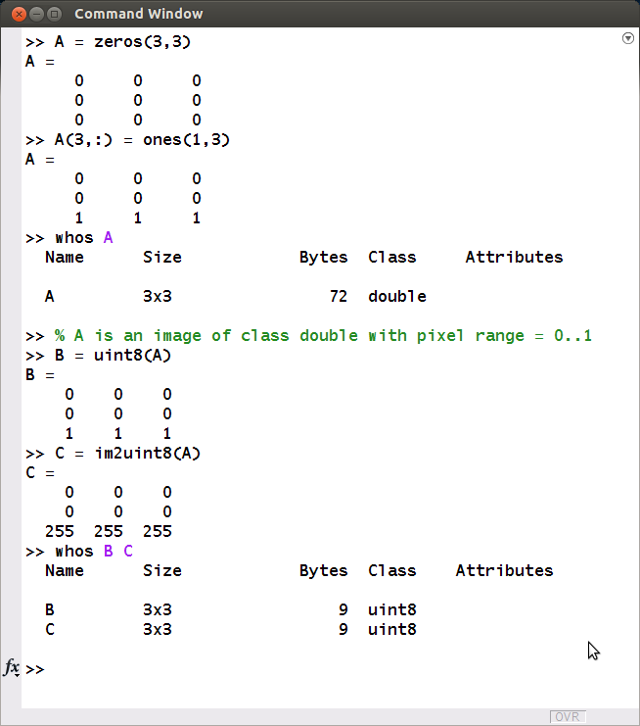
Image
conversion
vs
Type
conversion

Slide 11
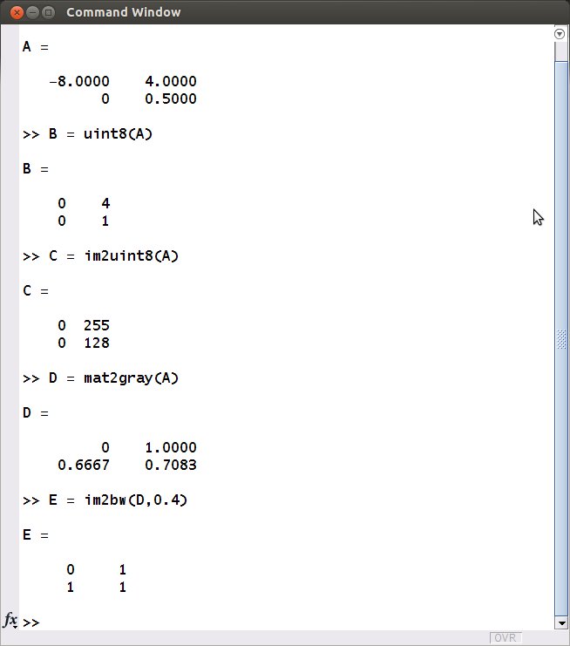

Slide 12
The Image Processing Toolbox (IPT): essential functions and features
Displaying the contents of an image
image: displays an image using the current colormap.
imagesc: scales image data to the full range of the current colormap and displays the image.
imshow: displays an image and contains a number of optimizations and optional parameters for property settings associated with image display.
imtool: displays an image and contains a number of associated tools that can be used to explore the image contents.

Slide 13
Image Display Functions
image
imagesc
imshow
imtool

Slide 14
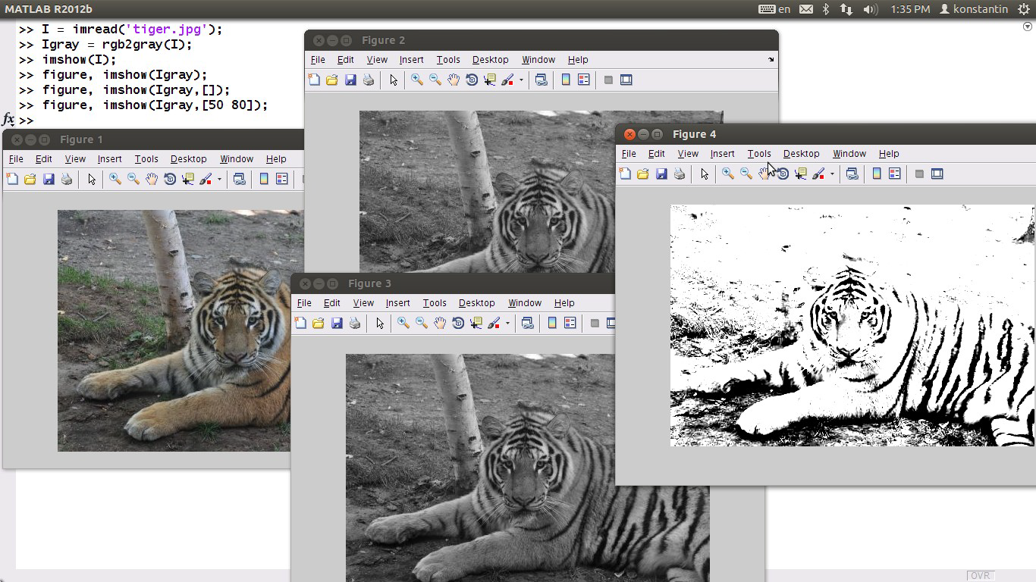
imshow(...)

Slide 15
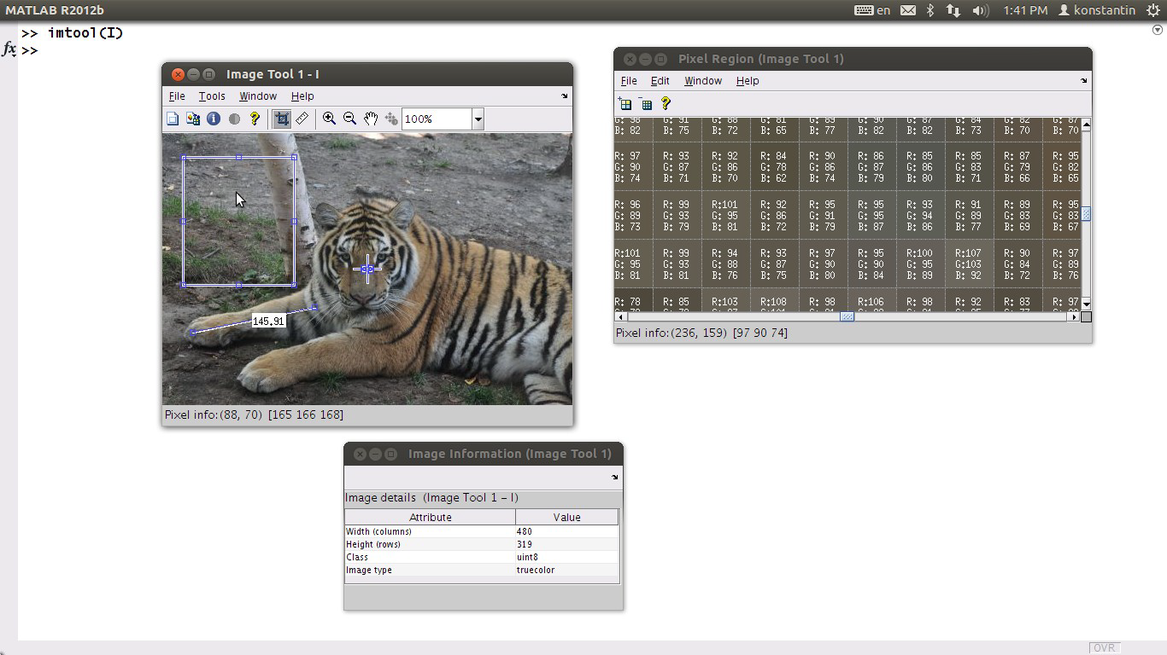
imtool(...)

Slide 16
The Image Processing Toolbox (IPT): essential functions and features
imwrite: Writing the resulting image onto a file
Example 4.4 (page 71)
I = imread('peppers.png');
imwrite(I, 'pep75.jpg');
imwrite(I, 'pep05.jpg', 'quality', 5); imwrite(I, 'pep95.jpg', 'quality', 95);

Slide 17
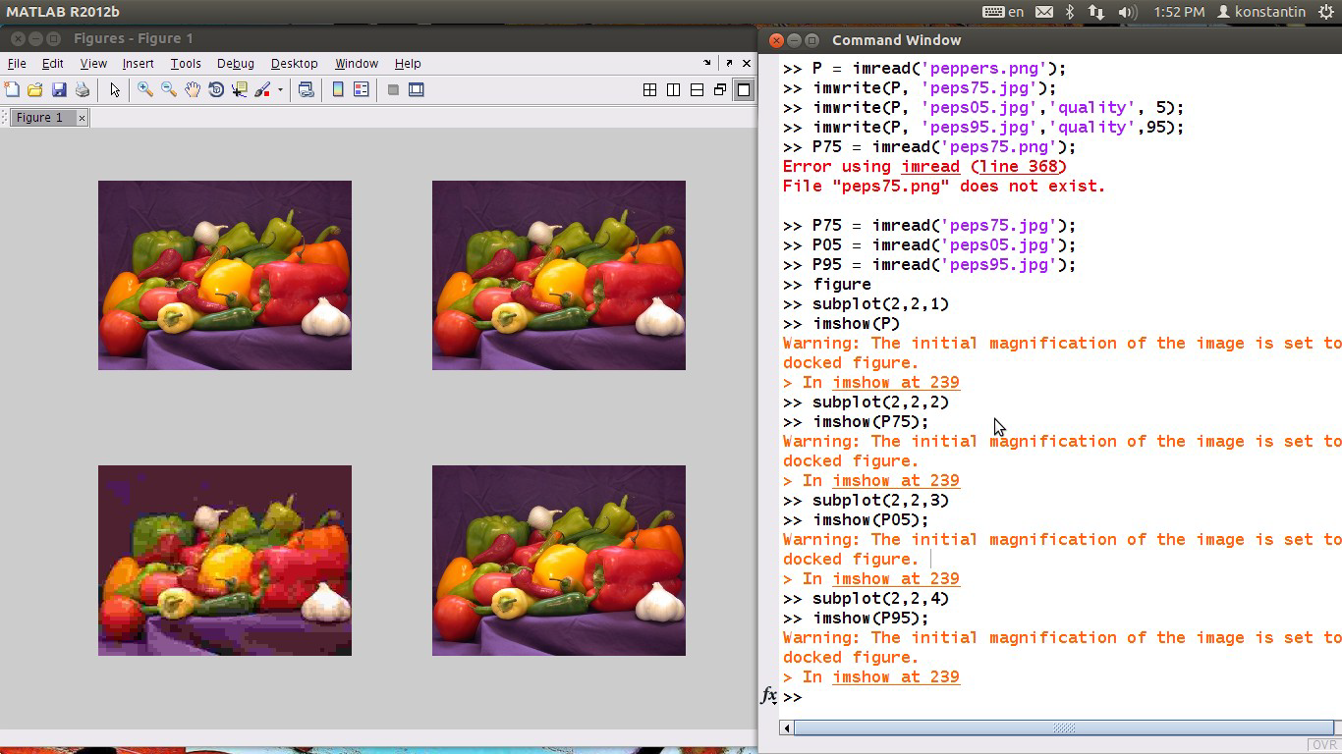
imwrite(...)

Slide 18
Practice and Homework
Tutorials of Chapter 4
Exercises in the end of Chapter 4 of textbook

